Slide 1
RECOVERY IN SUMMER 2021
Cathy, Sydney

Slide 2
Overview of the Source Model

Slide 3
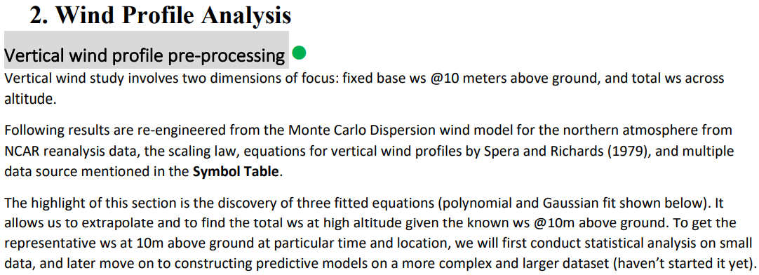
by UTAT teammate Kevin Li

Slide 4
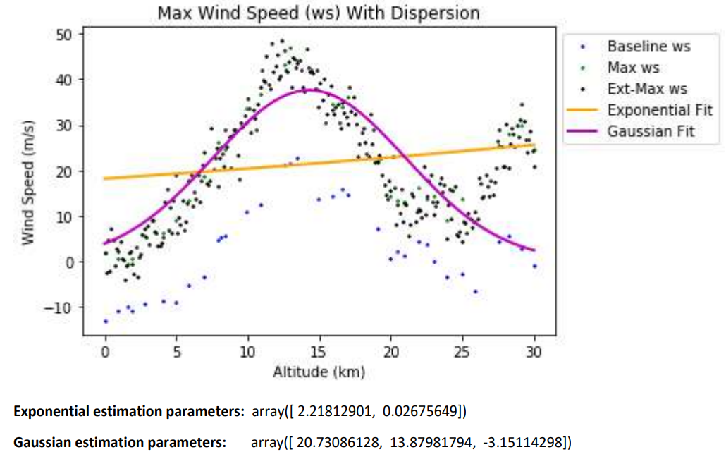
Note: due to calculation errors, the Gaussian parameters are changed to [37.55331224, 14.30107053, 6.7123204]

Slide 5
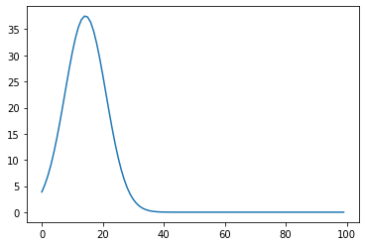
Summary
Wind speed under 25 km can be modeled by Gaussian Equation with the following parameters:
[37.55331224, 14.30107053, 6.7123204]

Slide 6
2. Parameters

Slide 7
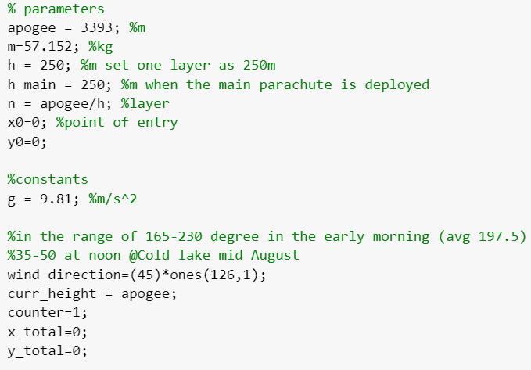
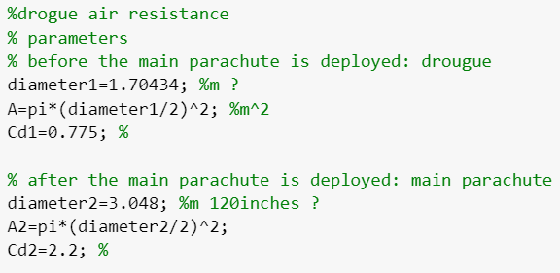
1. Mass of the liquid rocket;
2. Apogee;
3. Diameter of the drogue;
4. drag coefficient of the drogue;
5. Diameter of the main parachute;
6. drag coefficient of the main parachute;
7. Wind direction

Slide 8
3. Analytical Method

Slide 9
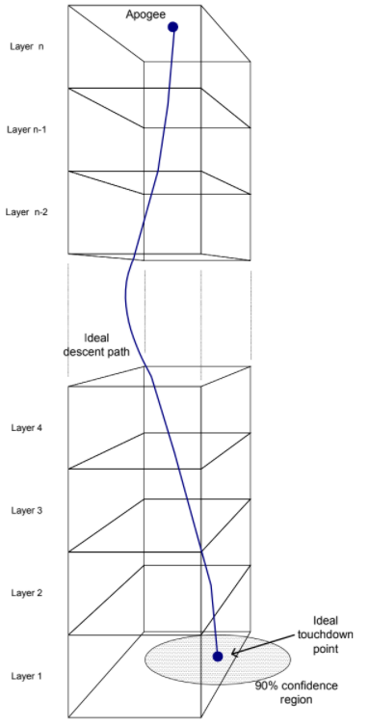
Descent velocity and wind velocity are analyzed layer by layer
Each layer is set to 250 meters, typically done by a while loop in the code
File location: https://drive.google.com/file/d/1ApJ7t-4WFUHMY30Iu0r475itEuXdMhPW/view?usp=sharing

Slide 10
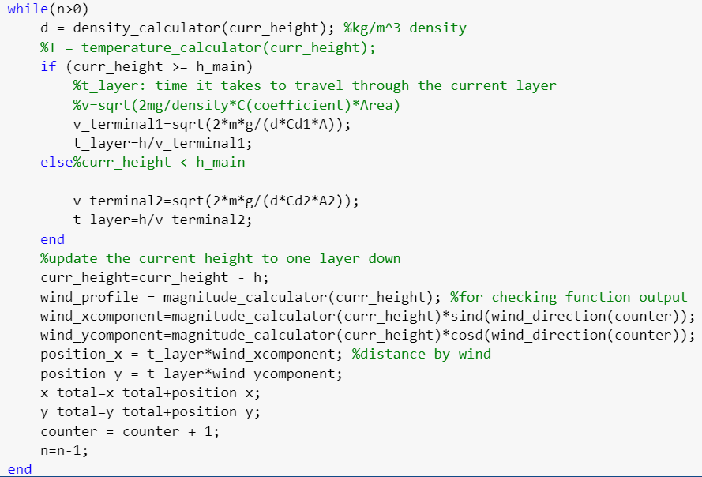

Slide 11
4. Standard Atmospheric Model
Summary: get the temperature -> get the density -> find the terminal velocity

Slide 12
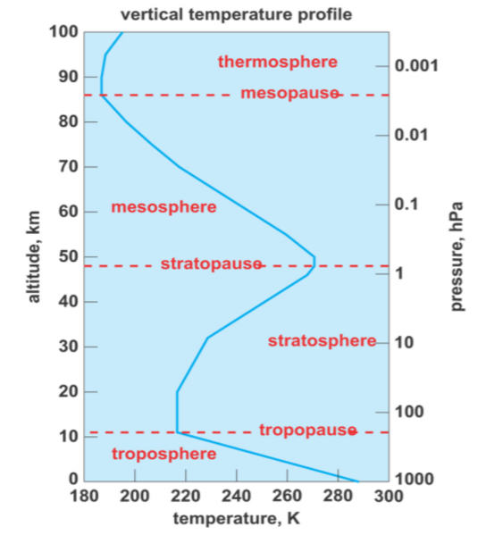
Variation of temperature with altitude
Gradient region
Isothermal region
File location: https://drive.google.com/file/d/1ApJ7t-4WFUHMY30Iu0r475itEuXdMhPW/view?usp=sharing
Notes:
https://nptel.ac.in/content/storage2/courses/101104007/Module1/Lec2.pdf

Slide 13
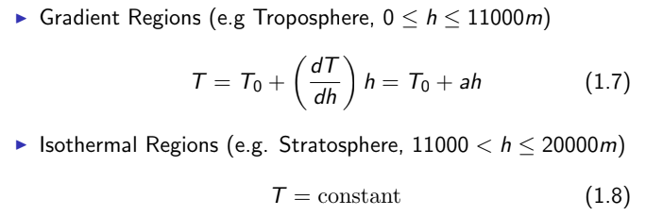
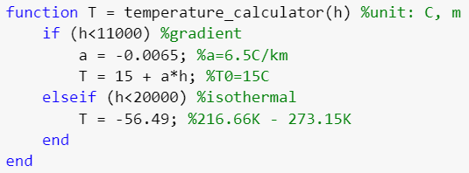
Temperature
Theory
MATLAB
Notes:
https://drive.google.com/file/d/1ApJ7t-4WFUHMY30Iu0r475itEuXdMhPW/view

Slide 14
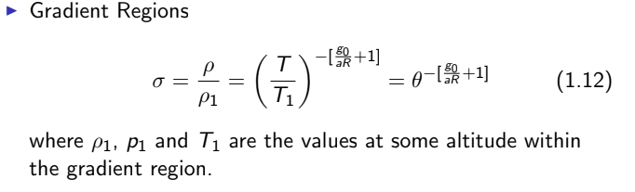
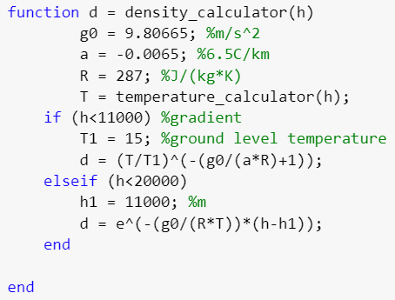
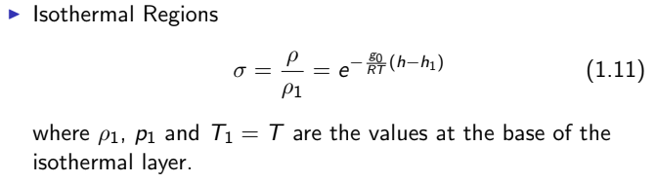
Density
Theory
MATLAB

Slide 15
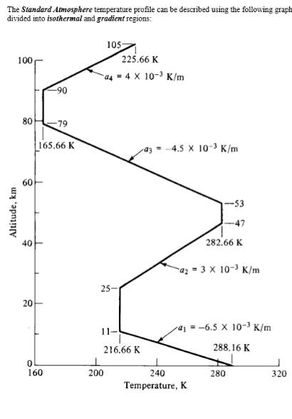
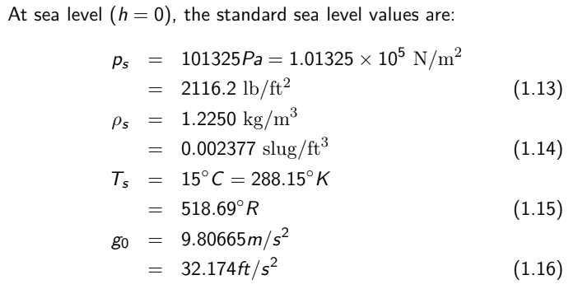
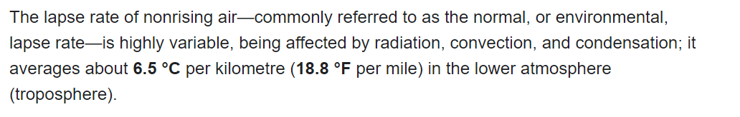
Constants
Notes:
https://www.chegg.com/homework-help/questions-and-answers/isothermal-regions-atmosphere-properties-found-temperature-pressure-density-known-base-bot-q35326064

Slide 16
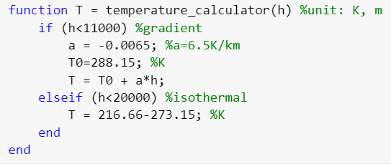
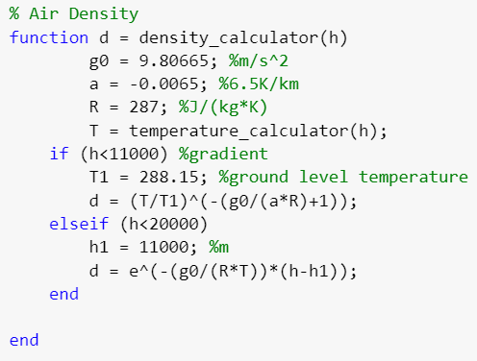

Slide 17
5. Outputs

Slide 18
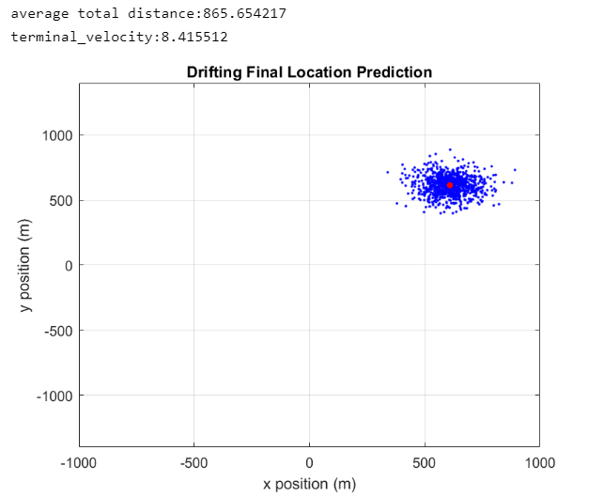
Average distance from the launch site;
Terminal velocity;
A scatter plot indicating the possible terminal x-y position (red) and its Gaussian uncertainties (blue) with a variance of 1

Slide 19
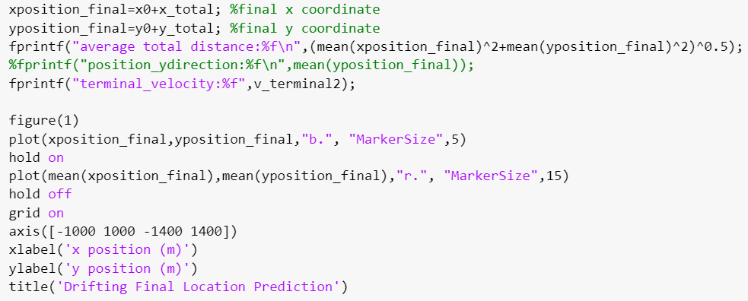
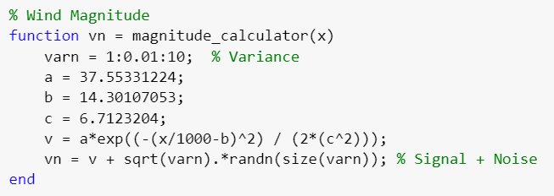
Gaussian Noise:

Slide 20
Next Step
Fix some bugs in this standard atmospheric model
Get wind profile for FAR launch site
Convert Drift Simulation to Python

Slide 21

Thanks for this great experience in the team!
Questions???

